Slide 1
ELASTIC COMPUTE CLOUD(EC2)

Slide 2
AGENDA
What is AMAZON EC2
Amazon Elastic computing
Common Use cases
Use case of EC2 by Wall street Example
EC2 Features

Slide 3
WHAT IS AMAZON EC2
Amazon Elastic Compute Cloud (Amazon EC2) provides scalable computing
capacity in the Amazon Web Services (AWS) cloud.
Using Amazon EC2 eliminates your need to invest in hardware up front, so you can develop and deploy applications faster. You can use Amazon EC2 to launch as many or as few virtual servers as you need, configure security and networking, and manage storage.
Amazon EC2 enables you to scale up or down to handle changes in requirements or spikes in popularity, reducing your need to forecast traffic.

Slide 4
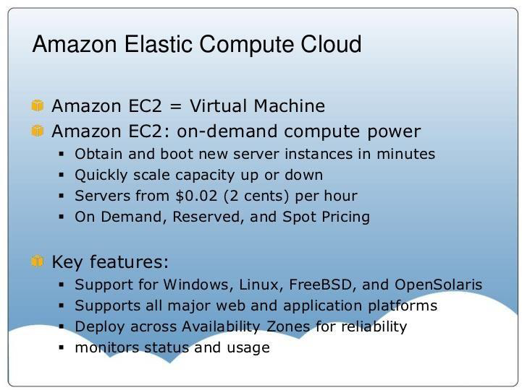
WHAT IS AMAZON EC2

Slide 5
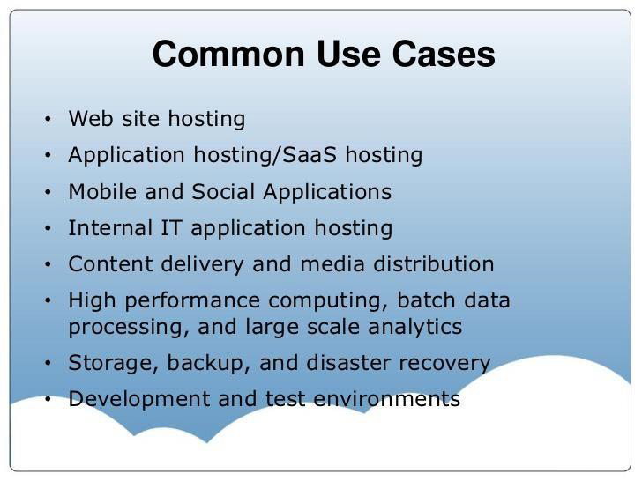
EC2 USE CASES

Slide 6
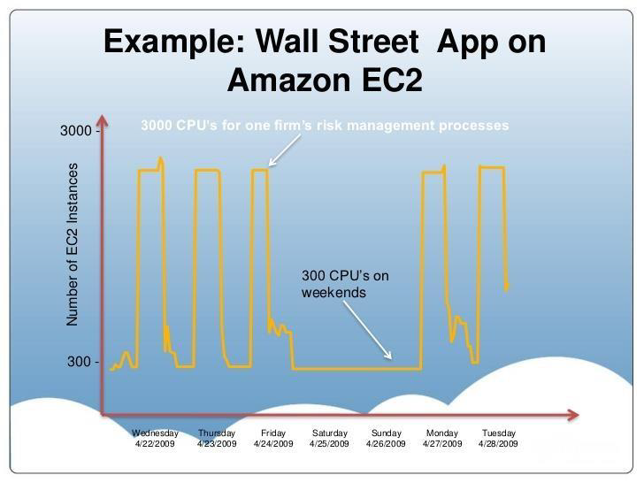
EXAMPLE UASGE

Slide 7
Features of Amazon EC2
Virtual computing environments, known as instances
Preconfigured templates for your instances, known as Amazon Machine Images (AMIs), that package the bits you need for your server (including the operating system and additional software)
Various configurations of CPU, memory, storage, and networking capacity for your instances, known as instance types
Secure login information for your instances using key pairs (AWS stores the public key, and you store the private key in a secure place)

Slide 8
Features of Amazon EC2
Storage volumes for temporary data that's deleted when you stop or terminate your instance, known as instance store volumes, Persistent storage volumes for your data using Elastic Block Store, known as Amazon EBS volumes
Multiple physical locations for your resources, such as instances and Amazon EBS volumes, known as regions and Availability Zones
A firewall that enables you to specify the protocols, ports, and source IP ranges that can reach your instances using security groups
Static IPv4 addresses for dynamic cloud computing, known as Elastic IP addresses

